Slide 1

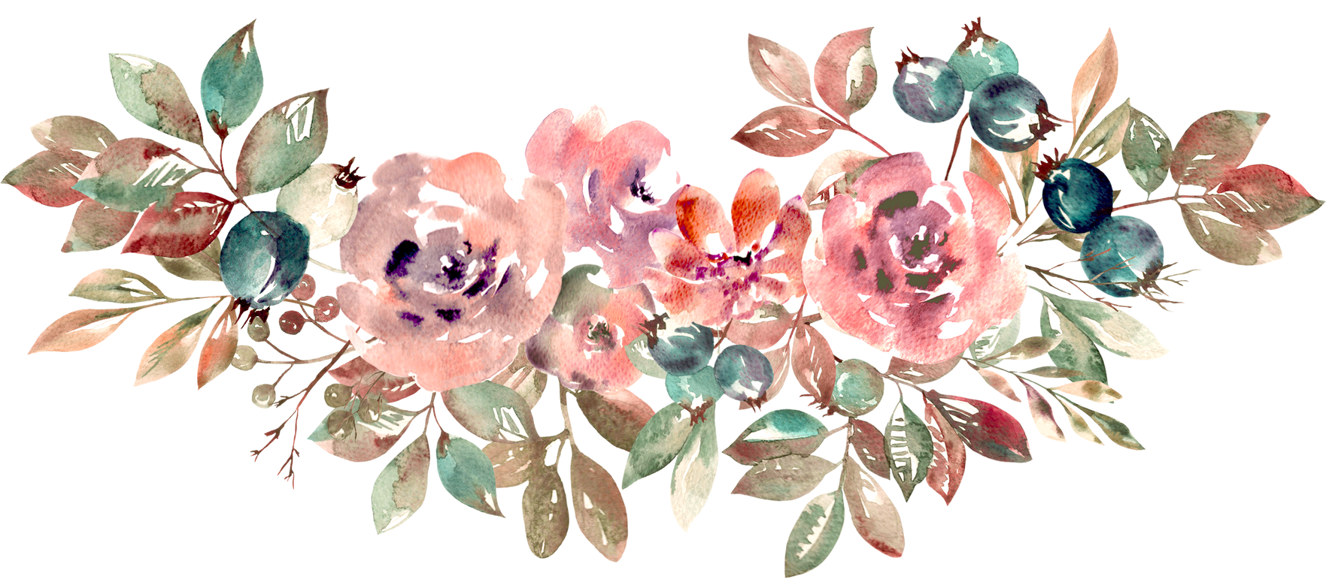

Presentation

Slide 2
DIGITAL PORTFOLIO
NAME:M. MANIKSHA. M
REG.NO:24131241802522018 &
NMID:72D1CCEF45570FAB3924196AFBF6B830
DEPARTMENT:BSC COMPUTER SCIENCE
COLLEGE:GOVERNMENT ARTS AND SCIENCE
COLLEGE, VADALUR

Slide 3
STUDENT DIGITAL PORTFOLIO
INTERACTIVE DIGITAL PORTFOLIO STUDENT PROFILE USING FRONT END WEB DEVELOPMENT FOR COLORING AND BOX METHOD OF CSS

Slide 4
AGENDA
PROBLEM STATEMENT
PROJECT OVERVIEW
END USERS
TOOLS & TECHNOLOGIES
PORTFOLIO DESIGN & LAYOUT
FEATURES & FUNCTIONALLY
RESULTS & SCREENSHOT
CONCLUSION

Slide 5
PROBLEM STATEMENT
PROBLEM DEFINITION: CLEARLY DESCRIBE THE ISSUE AT HAND.
CONTEXT: PROVIDE BACKGROUND INFORMATION AND
RELEVANT DETAILS SURROUNDING THE PROBLEM.
IMPACT: IDENTIFY THE CONSEQUENCES OR EFFECTS
RESULTING FROM THE PROBLEM.
GOALS: DEFINE WHAT YOU AIM TO ACHIEVE BY RESOLVING
THE PROBLEM.

Slide 6
PROJECT OVERVIEW
PROJECT DESCRIPTION: A SUMMARY OF THE PROJECT'S PURPOSE,
GOALS, AND OBJECTIVES.
SCOPE: DEFINES WHAT IS INCLUDED AND EXCLUDED FROM THE
PROJECT.
OBJECTIVES: SPECIFIC AND MEASURABLE OUTCOMES THE PROJECT
AIMS TO ACHIEVE.
TIMELINE & DELIVERABLES: KEY MILESTONES, DEADLINES, AND
EXPECTED OUTPUTS OR RESULTS

Slide 7
END USER
STUDENTS
MY RESUME
NAME: M. MANIKSHA
AGE: 18
FATHER'S NAME:P. MANICKAVEL
KNOWS OF PROGRAMMING LANGUAGE: PYTHON, C, C++, JAVA, HTML,CSS,JS, SQL
CONTACT MAIL ID:maniksha2006manickam@gmail.com

Slide 8
I AM A VERY SINCERE TO WORK AND
DEPTH PROGRAM KNOWLEDGE....
THANK YOU❤️
YOUR SINCERELY
M. MANIKSHA

Slide 9
NEXT PROFESSIONAL
ARE SEEING PROFILE AND RESUME..

Slide 10
TOOLS & TECHNOLOGIES
HTML-TAG & STRUCTURES
CSS-STYLING PROPERTY
JS-INTERACTIVITY
EDITOR-CODEPEN

Slide 11
PORTFOLIO DESIGN & LAYOUT
ABOUT ME
ACHIEVEMENT
CONTACT
SKILLS
INTERACTIVITY
WORKING
(MOBILE)

Slide 12
FEATURES &
FUNCTIONALITY
NAVIGATION BAR
RESPONSIVE DESIGN FOR ALL DEVICE
INTERACTIVE ELEMENTS
SMOOTH SCROLLING

Slide 13
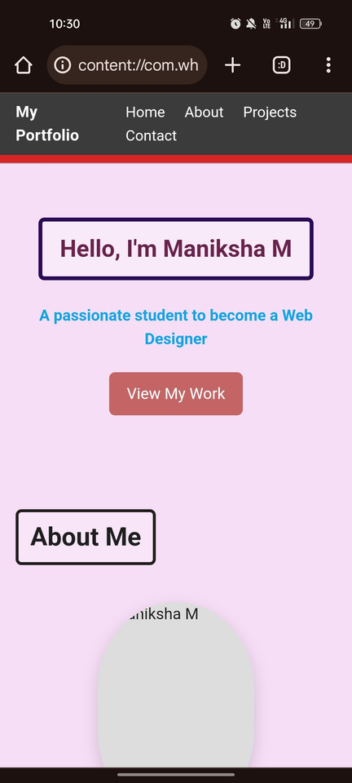
RESULT & SCREENSHORT

Slide 14
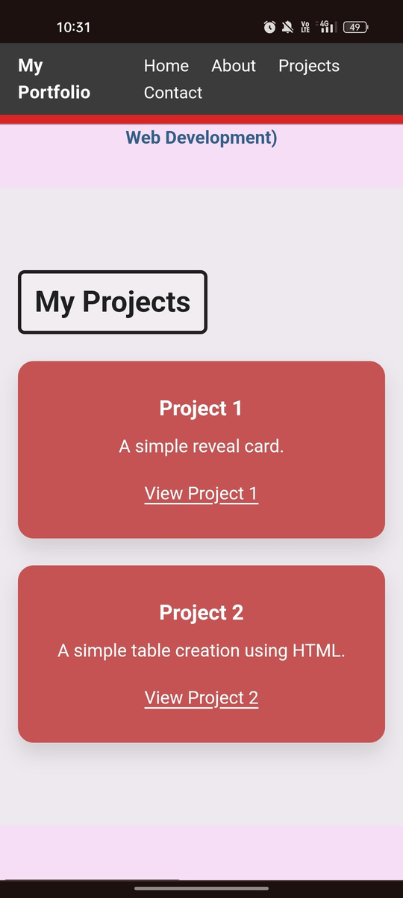

Slide 15
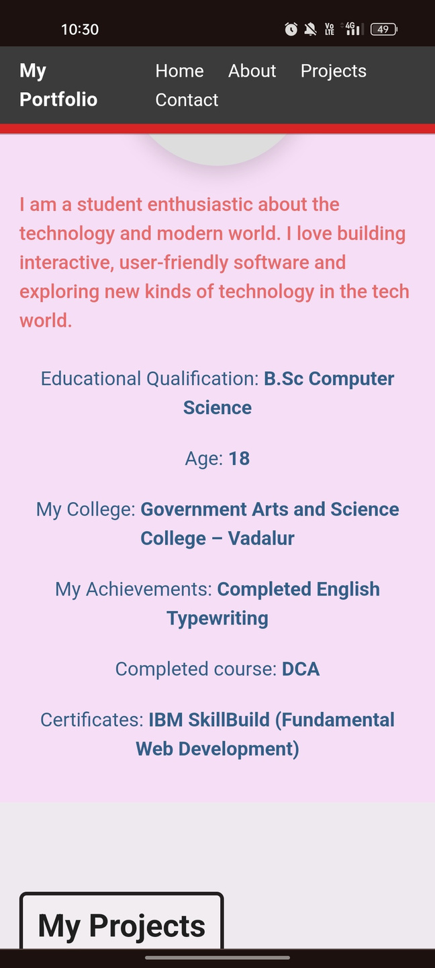

Slide 16
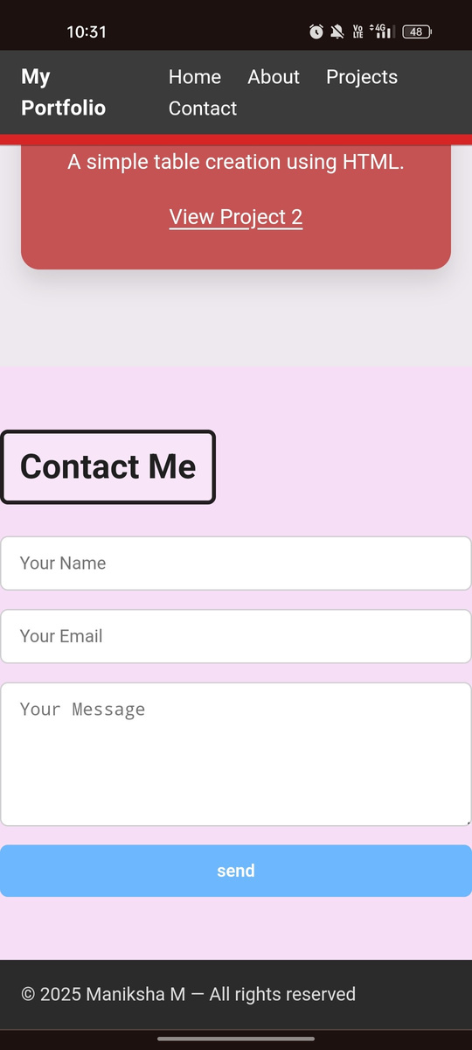

Slide 17
CONCLUSION
I AM REALLY EXCITED TO CREATE MY OWN
PPT FOR NAAN MUDHALVAN..

Slide 18
THANK YOU

